Slide 1



Final Presentation
Human-Computer Interaction
P8
Cristiano Nicolau 108536 LEI – 33,3%
Vasco Faria 107323 LEI – 33,3%
Joaquim Andrade 93432 LECI – 33,3%

Slide 2

In Today’s Society, having an organized life is fundamental.
However, not everyone can manage its personal tasks, the right way.
People have need to Scheduling activities and events.
Also there’s a need of noting down important tasks on the spot.
Simple Way to do All of This?
Notes:
Design a functional website where the main idea is to be a calendar synchronizer where work groups, projects,
friends can set dates to meet more easily, it also has the function of a personal agenda.
For us students, we know that it is very difficult to deal with going out with friends, exams and even projects and hobbies, so we talked about creating this calendar synchronizer to make our life easier.

Slide 3

Description
Calendar synchronizer where work groups, projects, friends can set dates to meet more easily. It also has the function of a personal agenda.
Main Goals
Help people with their duties in order to accomplish them in a more efficient way.
Simple and straightforward to use website

Slide 4


Age | Gender | Education | Location
20 years old | Male | Student | Aveiro
Joao Dias
Details
Needs | Wants | Values
More time for himself | Organize Life away more simple

Slide 5

Age | Gender | Work | Location
55 years old | Female | Housekeeper | Porto
Maria Santos
Details
Needs | Wants | Values
More time with family | Take control of his life and the lives of their children

Slide 6

Automate Life
Joao is a University Student and has several subjects with several group works.
He has a very busy life, as he likes to go to the gym and hang out with his friends.
With Syncal, João, marks in is calendar all the meetings for work, organizing his life having more time for himself

Slide 7
Make an appointment with the whole group
With Syncal, João accesses the different workgroups where he can schedule meetings in a calendar that only has available free time for all users, he also has a chat to communicate
Joao is a University Student and has several subjects with several group works.
He must schedule meetings with the different working groups to do the projects

Slide 8
Care of sons and be more efficient
Maria is a mother of 4 children. She still takes care of housework and take children to school and extracurricular activities.
She liked having more control over her children's schedule, so she could get everything done.
With Syncal, Maria has access to her children's calendars, having greater control over her children, managing to adjust her own schedule with that of her children
Obs: Future Work

Slide 9

2- Log into Syncal
3- Click in new calendar
4- Create a new Calendar
1- Register In Syncal
5- Click in My Schedules
6- Click Add Schedules
7- Create new appointments
0- Automate Life
Obs: If user don-t have account do: 1; If user don-t have Calendar do: 3 and 4 else go to 5

Slide 10
2- Log into Syncal
3- Click in new Group
4- Create a new Group
1- Register In Syncal
5- Click in Chat Groups
6- Click on the Group you wants
7- Click in calendar
8- Click Add Schedule
0- Make an appointment with the whole group
9- Create an appointment for entire group
10- Click Go back
11- Send a message indicate the appointement
Obs: If user don-t have account do: 1; If user don-t have Group do: 3 and 4 else go to 5

Slide 11


Non-Functional
Performance:
The application should respond quickly to user interactions and minimalistic
Usability:
The user interface should be intuitive and easy to navigate, allowing users to quickly understand and help users recover from their errors
The application must adhere to accessibility standards, allowing users with disabilities to access and use the calendar effectively.
Security:
Data privacy: Personal calendar data should be protected and only accessible to authorized users

Slide 12
Functional
Have a personal calendar
Personal Notes and Tasks
Control permissions of calendar and share them with other people
Create groups of work
Groups have a calendar that combine everyone's personal calendars
Create chat Groups
Add/Delele friends
Groups calendars

Slide 13
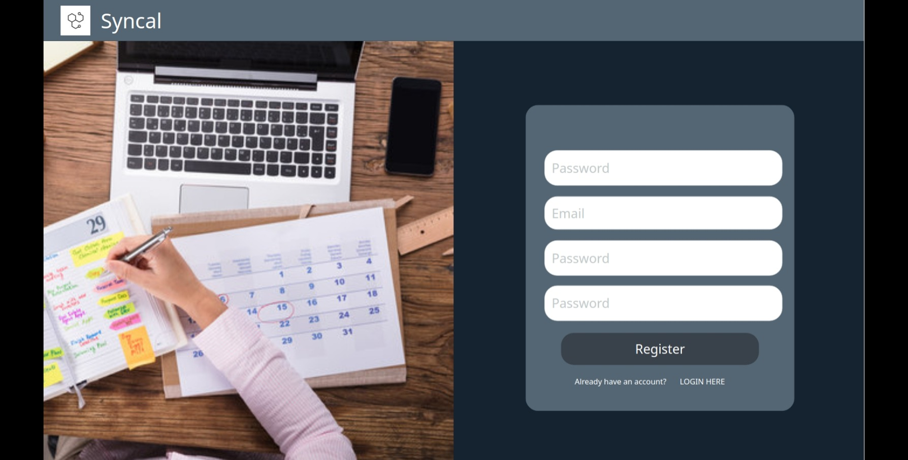
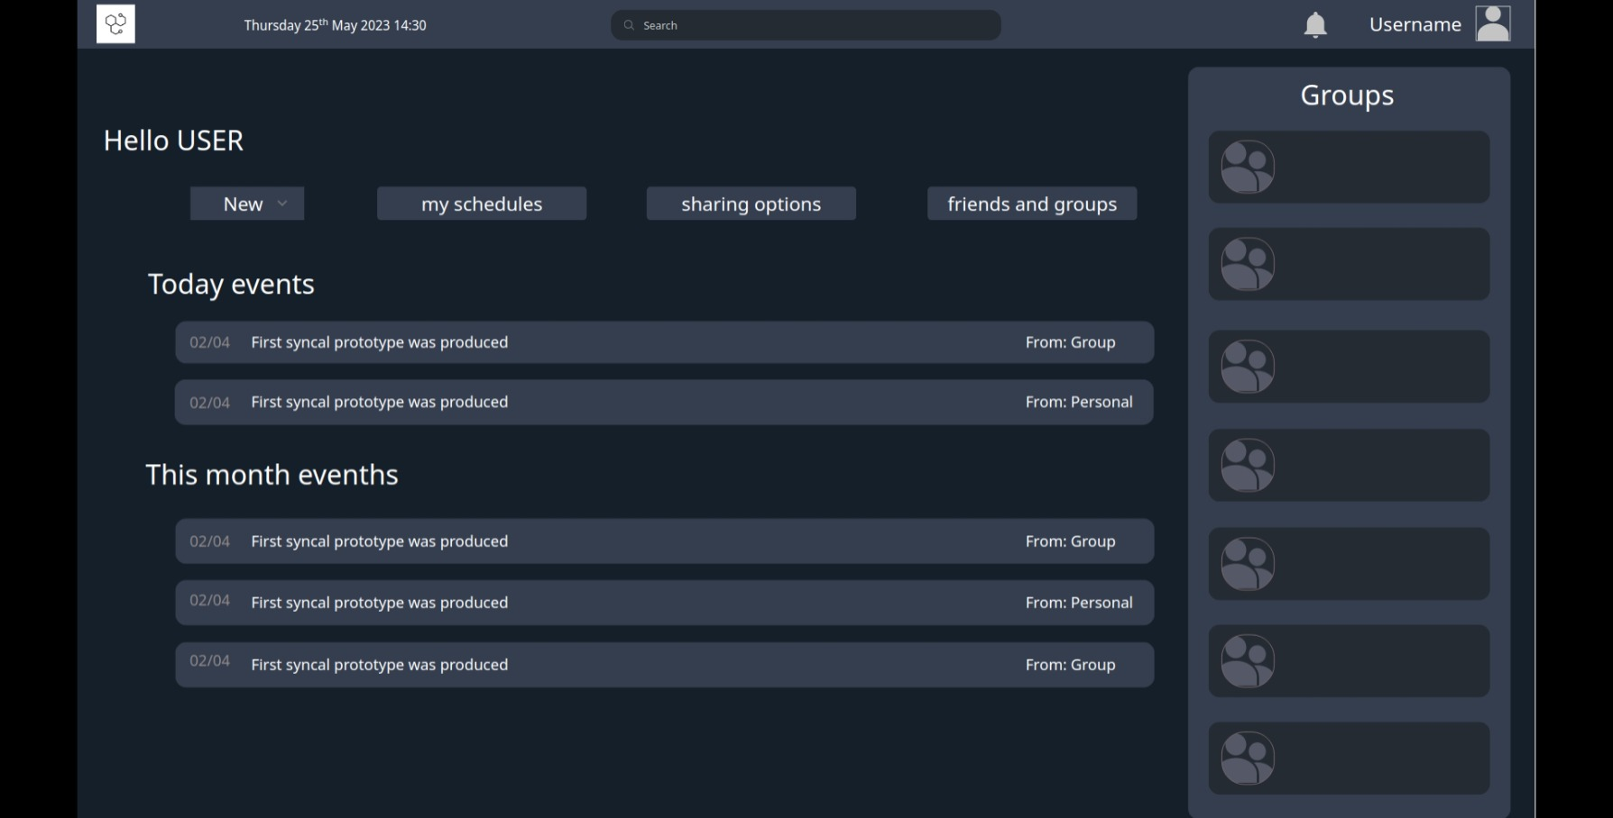
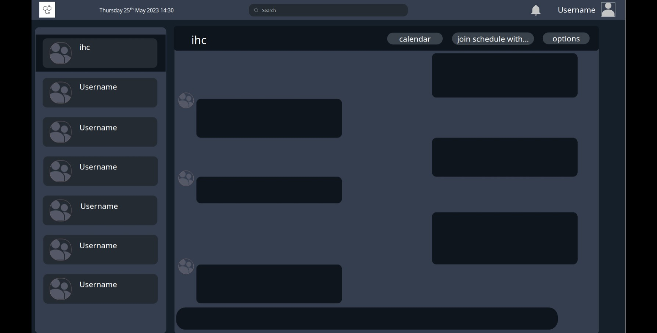
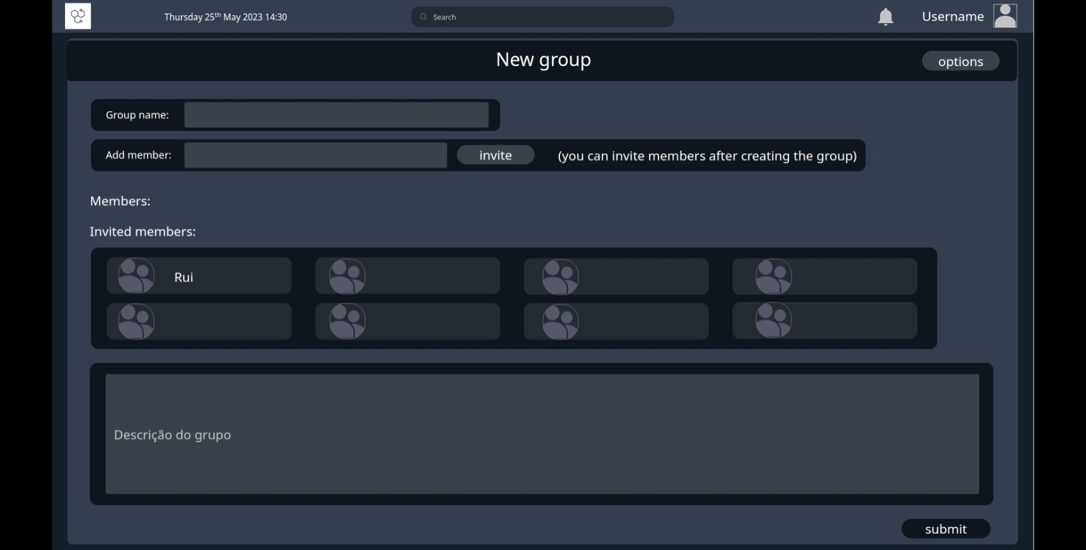
Low Fidelity Prototype (LFP)
Digital Prototype made with Proto.io

Slide 14

User Evaluation
Low Fidelity Prototype
Our tests mainly focused on sitting next to the participants and taking notes of their behaviors while doing the Use Cases.
After this, we asked and took notes of the participant's feedback to increase the system .
Tasks:
Register on the website.
Login
View IHC calendar
Create event in IHC calendar
Add IHC group calendar to personal calendar
Create new group
Join a chat
Total of eight (8) participant's.

Slide 15




Website based on React JS
Frameworks: Bootstrap
GitHub and Visual Studio Code

Slide 16
User Evaluation of the Functional Prototype
For this evaluation we used the same strategy used on the LFP but we change some the cases used.
We also give a post questionnaire for the participants to increase the received feedback.
Tasks:
Register on the website.
Login
Create appointement
See What is the information of today's 14:00 event.​
Enter the 'Futebolada' chat and send a message.
Open the calendar. What is the event on June 1st.
Create an event on May 17th at 16:30, 'Compilers Test'.
Log out
Total of nine (9) participant's

Slide 17
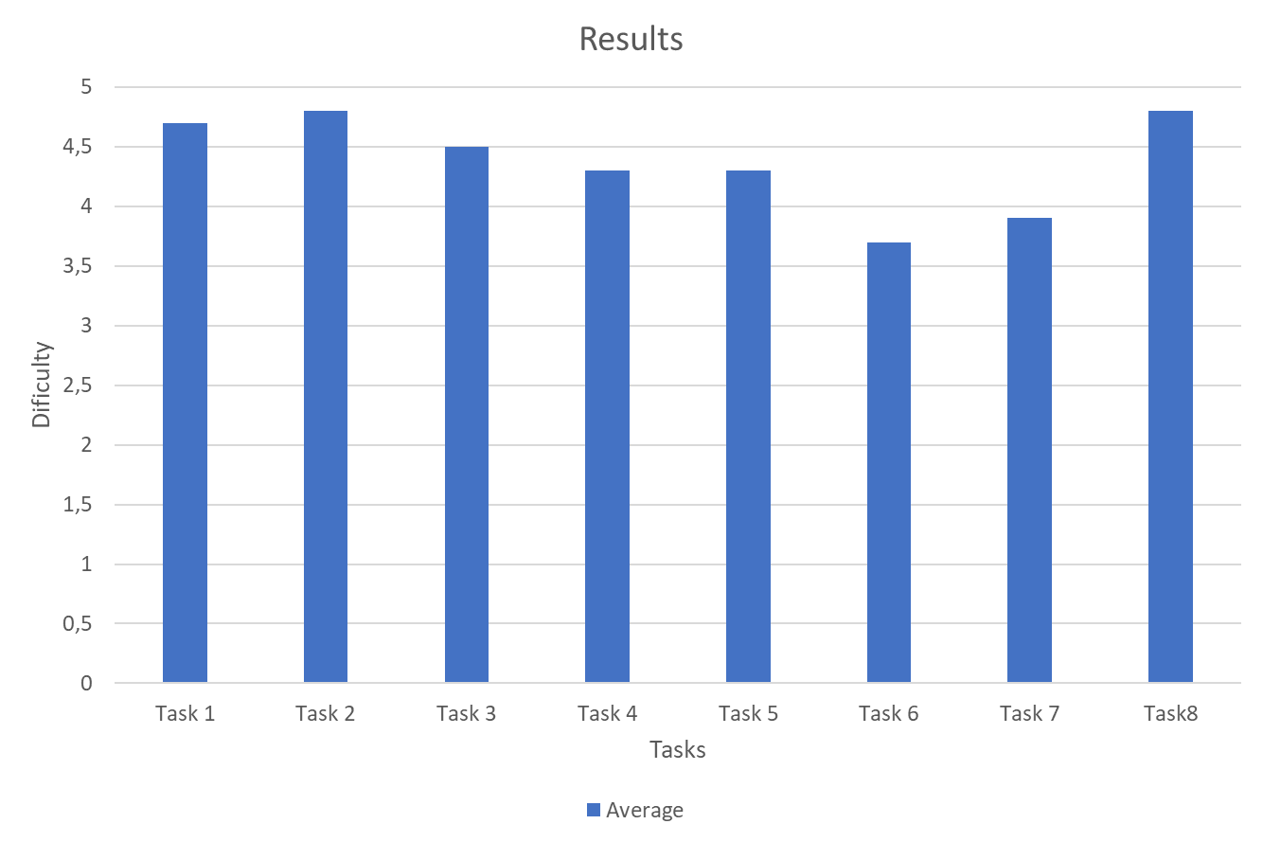
Usability Tests

Slide 18
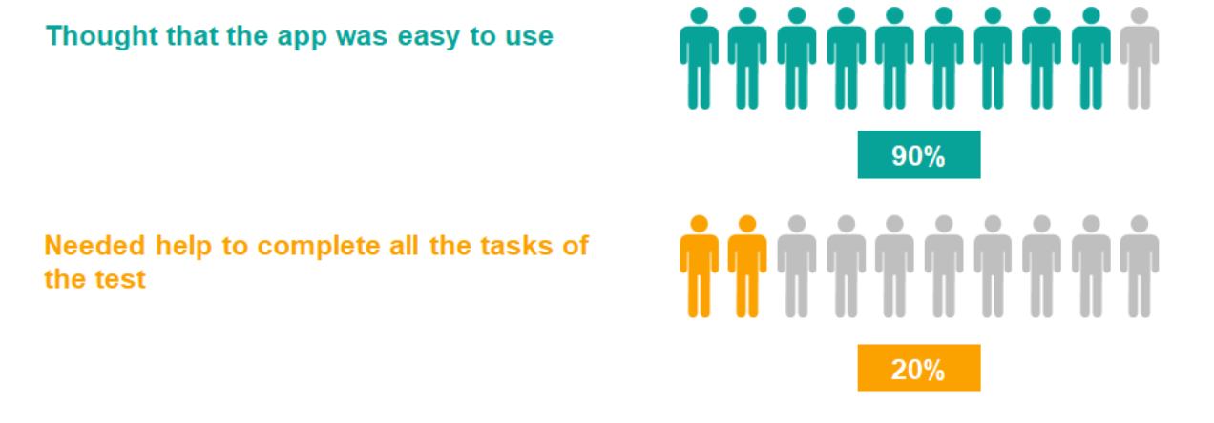
Usability Tests - Results

Slide 19
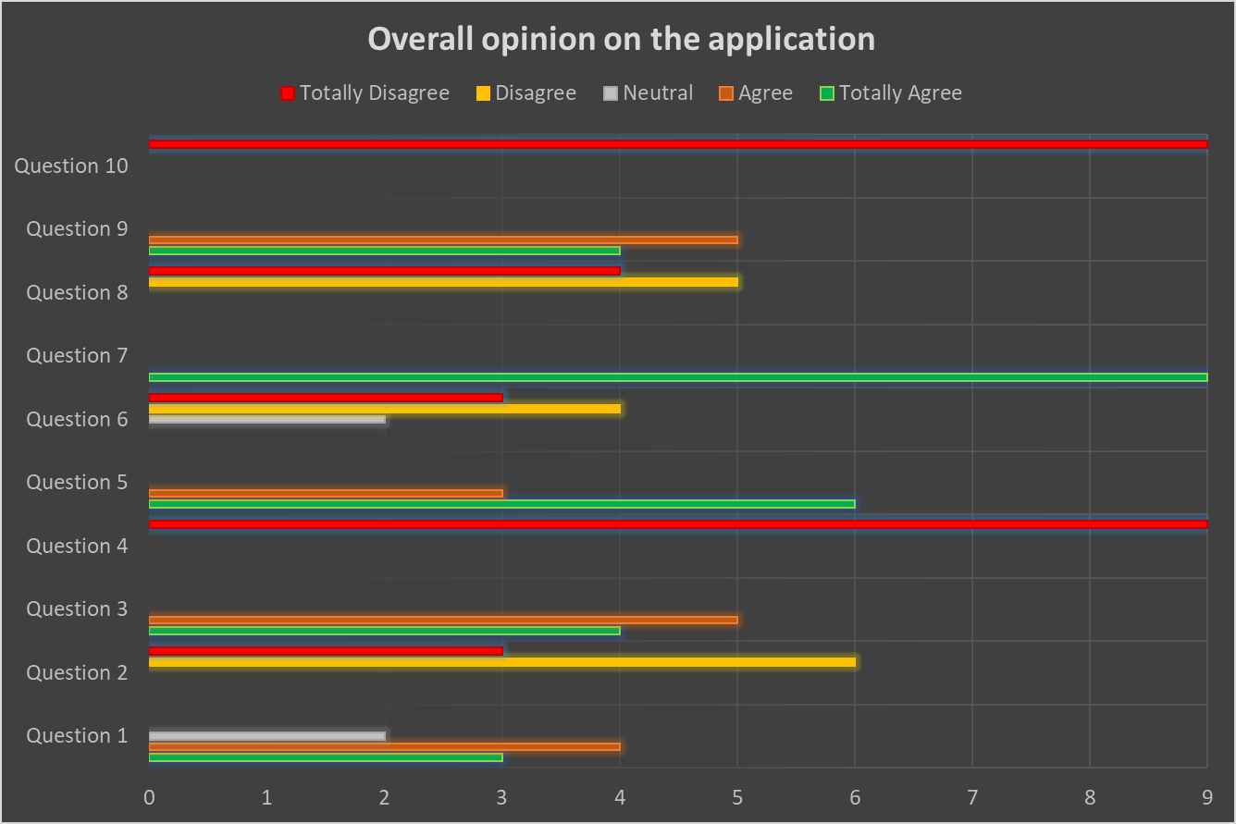
Usability Tests - Results
SUS average Score: 88

Slide 20
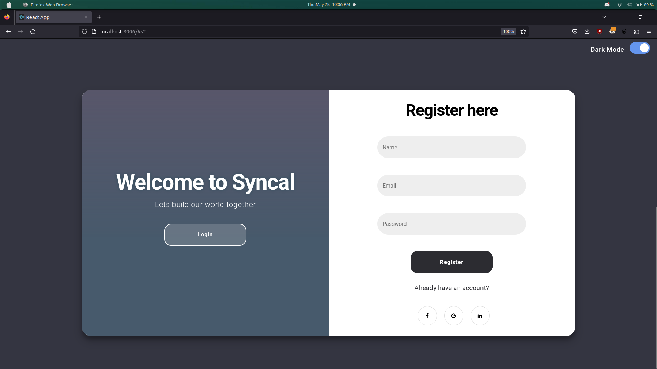
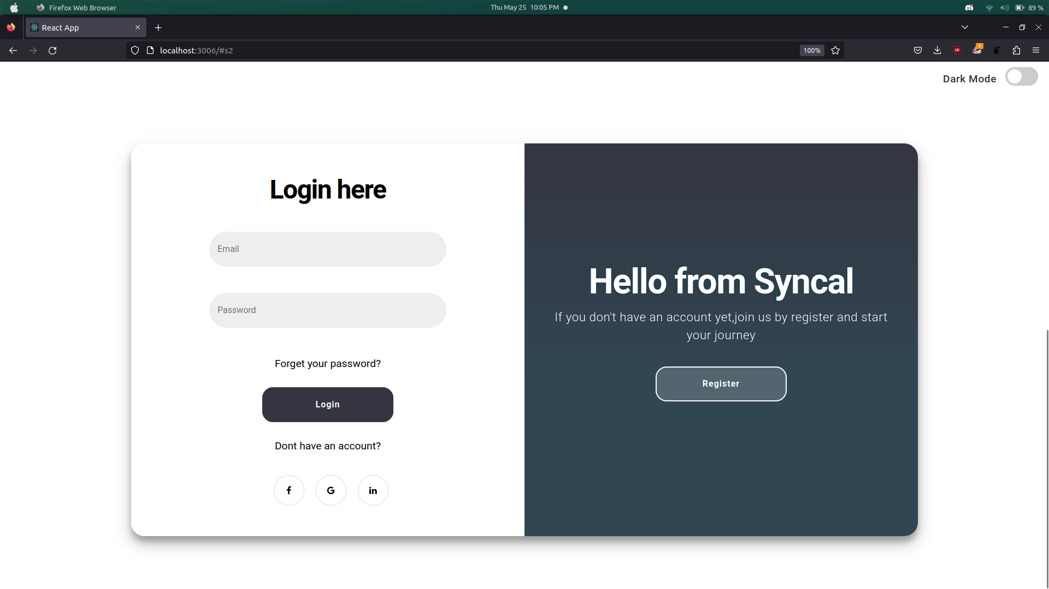
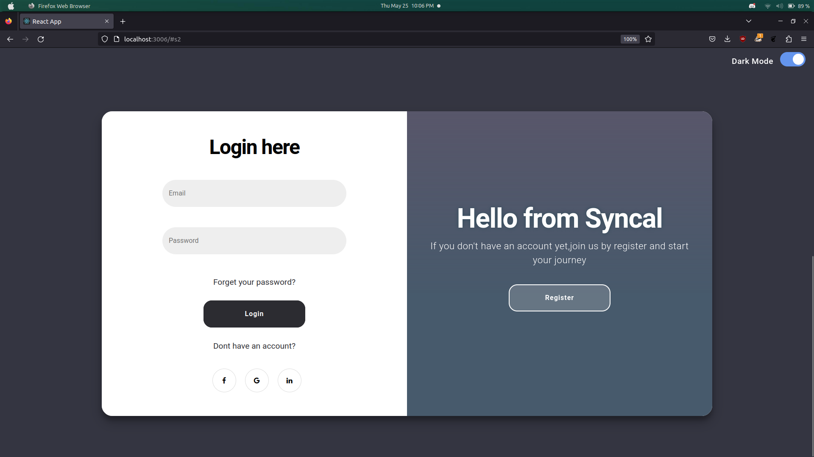
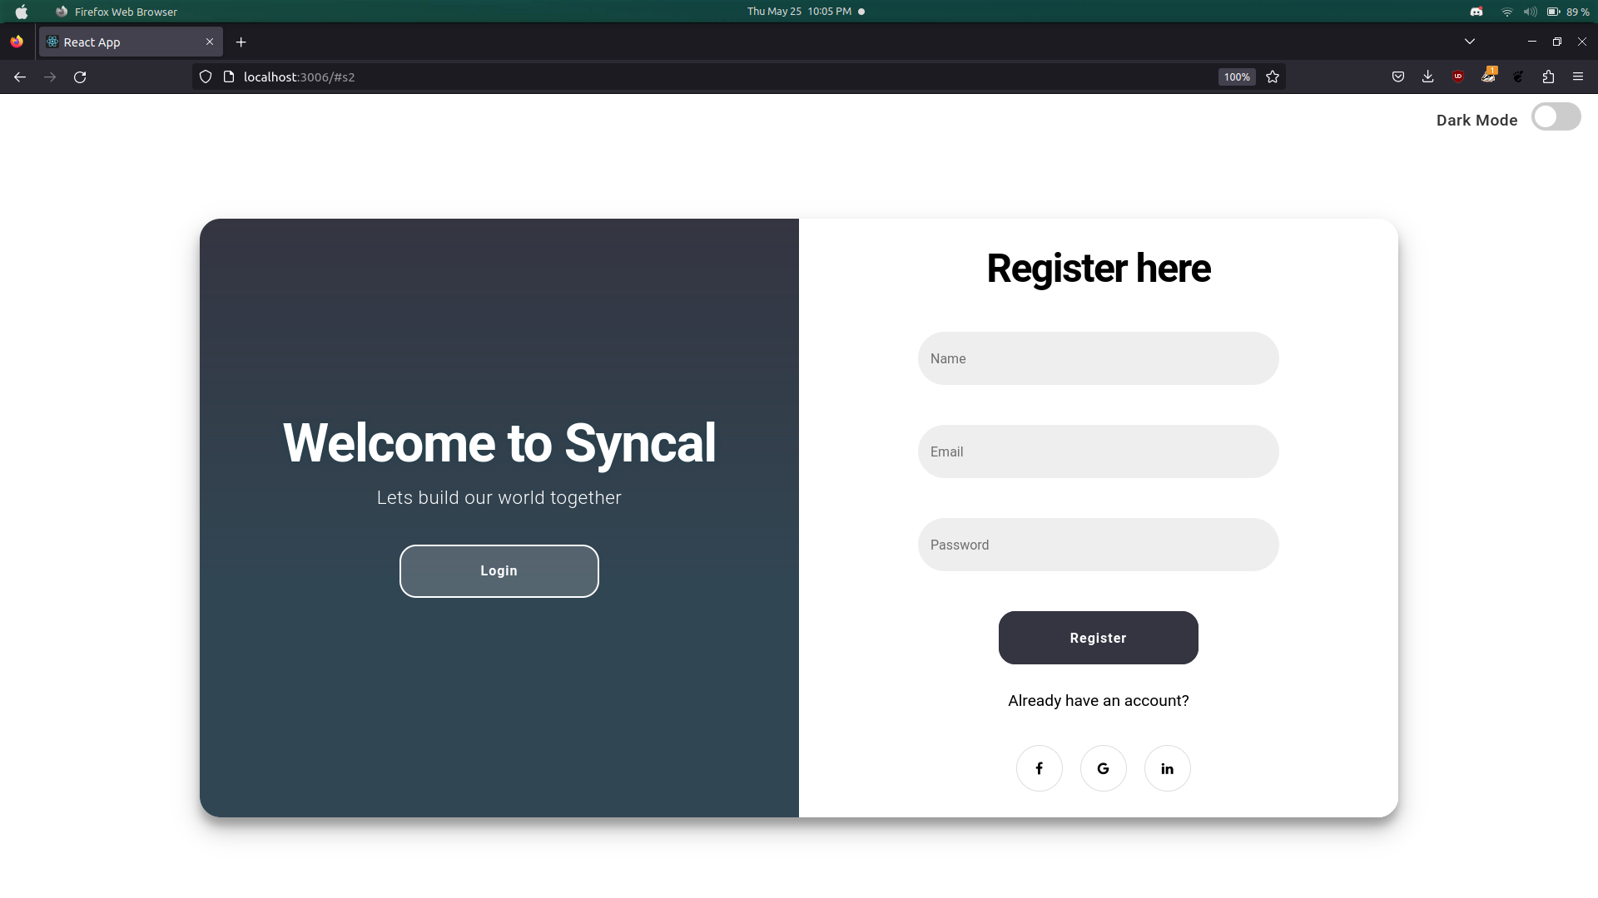
User Evaluation
Problem: Login/Register container and text are very small, and the color is very light

Slide 21
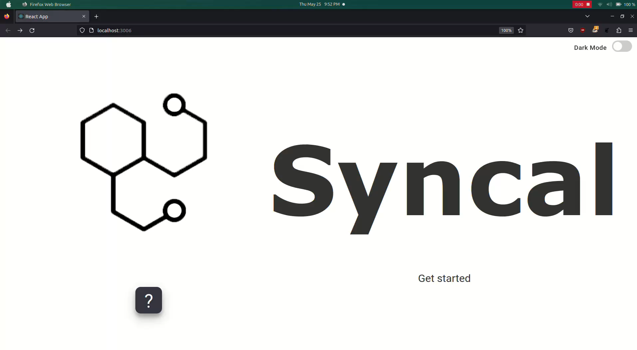
User Evaluation
Problem: After registering on the site, the page reloads to the beginning and the user does not know if he has registered

Slide 22
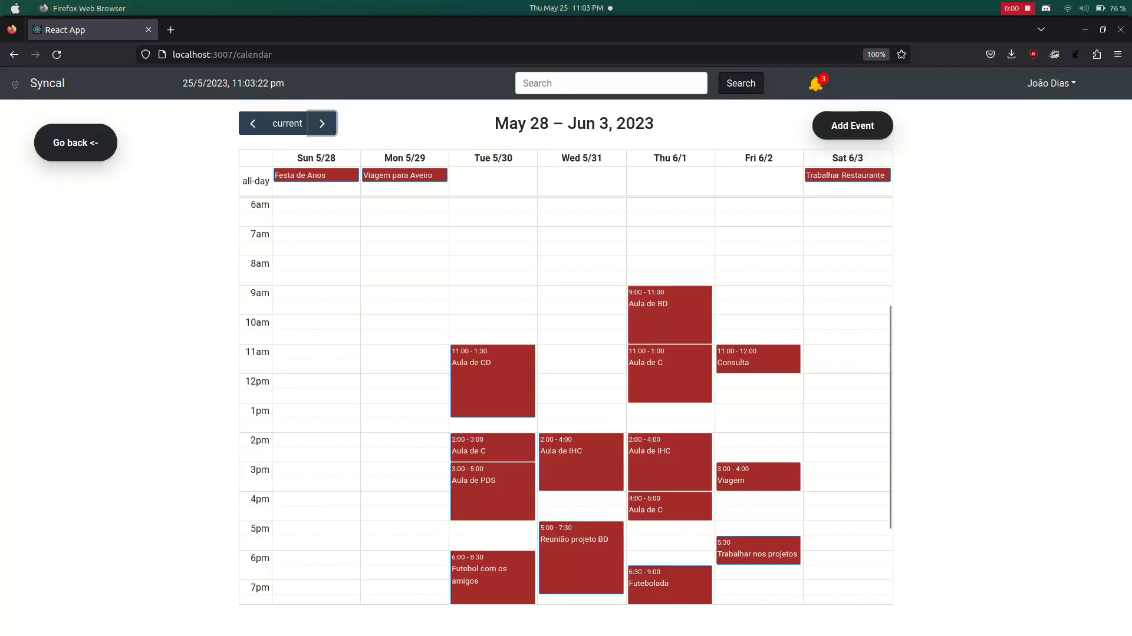
User Evaluation
Problem: Create appointment directly in calendar

Slide 23
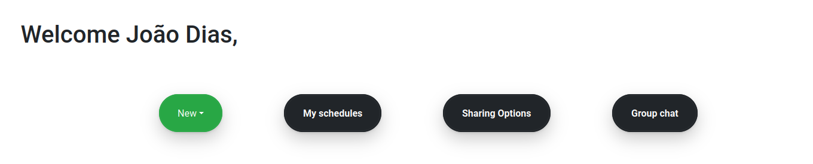
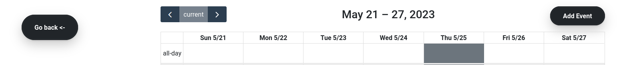
User Evaluation
Problem: Small and imperceptible buttons and don't have a button to go back

Slide 24
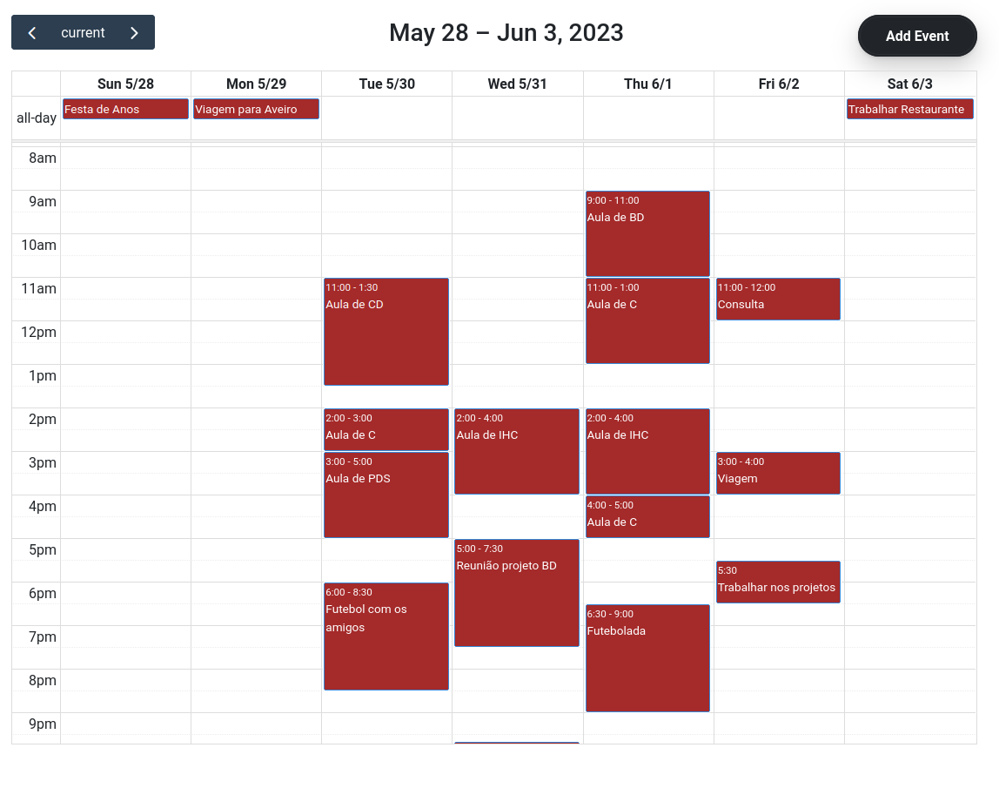
User Evaluation
Problem: The color of the calendar had the same color of the days and events

Slide 25
Live Demo

Slide 26
The Future of SYNCAL
Database
Add Features
mobile webapp

Slide 27
Conclusion

